Slide 1
ADOPTION OF FISCAL AND FINANCIAL INCENTIVES FOR ATTRACTING FOREIGN DIRECT INVESTMENT

Slide 2
OBJECTIVES OF THE LECTURE
To analyse theoretical points of view towards FDI
To understand factors influencing FDI flows
To understand the need of measures adopted for attracting FDI

Slide 3
Definition
Foreign Direct Investment - investments made by individuals or enterprises that have their centre of economic interest in an economy other than the economy in which they invest.
Foreign Direct Investment is a flow of lending to or purchase of ownership in, a foreign enterprise that is largely owned by residents of the investing country.
Foreign Direct Investment is established when a resident in one economy owns 10 per cent or more of the ordinary shares or voting power of an enterprise in the foreign country,

Slide 4
Classification of Foreign Direct Investment
Horizontal FDI – corporations make “horizontal” investments to produce abroad the same lines of goods as they produce in the home market, thus exploiting their monopolistic or oligopolistic advantages.
Vertical FDI –the purpose of exploiting raw material or other input abroad to their production process at home (backward vertical FDI) or to be closer to the customers through acquisition of distribution outlets (forward vertical FDI).
Conglomerate FDI – includes both horizontal and vertical FDI.

Slide 5
Forms of Foreign Direct Investment
Greenfield FDI is involved in establishing new production, distribution or other facilities in the host country.
Mergers and acquisition - may occur through an acquisition of or a merger with an established firm in the host country.
Brownfield FDI when a foreign investor formally acquires a firm, but replaces almost completely resources and capabilities of the acquired firm.
Joint ventures - either with a host country firm or a government institution, or with another company that is foreign to the host country

Slide 6
Theories of FDI
Neoclassical financial theory
Neoclassical trade theory
Industrial Organization Theory
New Trade Theory
The Kojima Hypothesis
Dependencia School
OLI paradigm
Uppsala school
Market imperfection theory
International production theory
Internationalization theory of New globally born companies

Slide 7
Theoretical Background
Two approaches:
Positive (Humphreys, Padgett 2006; (Gui-diby, Renard, 2015) find the host country benefit from FDI just in short-term. However, the interest in attracting FDI and its significance has increased several decades later.
Negative (Brown 1950; Chase-Dunn 1975; Kahouli, Maktouf 2015; Xu Xu, Sylwester 2016; Völlmecke et al 2016). These scientists emphasize that the main negative consequence of activating inward FDI stimulation is that the host economy becomes dependent on foreign capital over a certain period of time and MNCs have effect on decisions of the host government.

Slide 8
Theoretical Background
The role of FDI is twofold (Demir 2016; Lin, Kwan 2016; Sahin, Ege, 2015; Choi et. al 2016; Lien, Filatotchev 2015; Hymer 1971) :
FDI positively influences the growth of host economy as it creates new job places, domestic companies improve their technological processes due spillovers of “know-how”.
large MNCs “push out” of the market local player, or start headhunting and cause brain drain from domestic companies.

Slide 9
Theoretical Background
market imperfection theory states that MNCs move their activity to the host country to explore their own competitive advantages over the domestic capital .

Slide 10
Theoretical Background
The oligopoly reaction theory defines MNCs willingness to avoid or to reduce business risk
FDI is considered a driving force of economic growth. For this reason, most countries try to attract FDI at any cost.

Slide 11
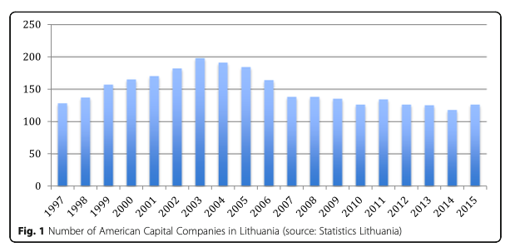
FDI from the U.S

Slide 12
Trends in the Baltic States: Lithuania

Slide 13
Trends in the Baltic States: Latvia

Slide 14
Trends in the Baltic States: Estonia

Slide 15
Relationships between Scandinavian and the Baltic States: Lithuania’s Case
Factor | FDI Denmark | FDI Iceland | FDI Finland | FDI Norway | FDI Sweden
GDP | -0,734 | 0,224 | 0,387 | 0,929 | 0,881
Exports | -0,696 | 0,094 | 0,433 | 0,909 | 0,880
Salaries | -0,757 | 0,084 | 0,495 | 0,958 | 0,953
R&D | 0,084 | 0,637 | -0,128 | 0,736 | 0,477
Scientific potential | 0,255 | 0,659 | -0,102 | 0,653 | 0,353
Expenditures on education | -0,942 | -0,953 | 0,255 | 0,845 | 0,253
Unemploy-ment | -0,732 | -0,346 | 0,285 | 0,653 | 0,736
R
R² | 0,824 | 0,801 | 0,681 | 0,962 | 0,968

Slide 16
Relationships between Scandinavian and the Baltic States: Latvia’s Case
Factor | FDI Denmark | FDI Iceland | FDI Finland | FDI Norway | FDI Sweden
GDP | 0,830 | 0,672 | 0,843 | 0,822 | 0,890
Exports | 0,610 | 0,519 | 0,693 | 0,942 | 0,948
Salaries | 0,797 | 0,695 | 0,768 | 0,837 | 0,896
R&D | 0,733 | 0,529 | 0,693 | 0,633 | 0,688
Scientific potential | 0,739 | 0,679 | 0,633 | -0,01 | 0,110
Expenditures on education | 0,970 | 0,931 | 0,947 | 0,603 | 0,723
Unemployment | 0,201 | -0,230 | -0,262 | 0,004 | 0,037
R | 0,991 | 0,987 | 0,987 | 0,968 | 0,988
R² | 0,981 | 0,975 | 0,975 | 0,940 | 0,976

Slide 17
Relationships between Scandinavian and the Baltic States: Estonia’s Case
Factor | FDI Denmark | FDI Iceland | FDI Finland | FDI Norway | FDI Sweden
GDP | 0,729 | 0,372 | 0,460 | 0,893 | 0,802
Exports | 0,833 | 0,403 | 0,417 | 0,887 | 0,912
Salaries | 0,784 | 0,395 | 0,752 | 0,501 | 0,769
R&D | 0,773 | 0,357 | 0,546 | 0,752 | 0,828
Scientific potential | 0,635 | 0,351 | 0,867 | 0,556 | 0,563
Expenditures on education | 0,803 | 0,461 | 0,466 | 0,683 | 0,903
Unemployment | -0,226 | -0,444 | 0,263 | -0,243 | -0,186
R | 0,867 | 0,922 | 0,971 | 0,733 | 0,999
R² | 0,752 | 0,849 | 0,942 | 0,586 | 0,999

Slide 18
Motives for Foreign Direct Investment
Region/Motives | Central and Eastern Europe | Russia | Asia | Africa | Middle East
Market-seeking | 3 | 5 | 5 | 5 | 5
Resource-seeking | 5 | 4 | 4 | 1,2 | 2
Efficiency-seeking | 1 | 1 | 1 | 1,2 | 1
Asset-seeking | 4 | 3 | 3 | 3 | 4
Risk Diversification | 2 | 2 | 2 | 4 | 3

Slide 19
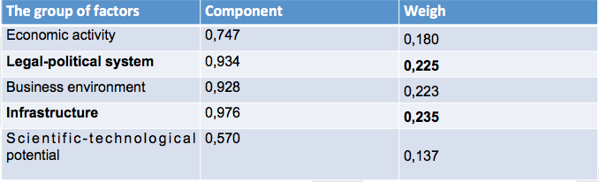
Identification Of The Country’s Attractiveness Factors For Foreign Direct Investments: Estonia’s Case

Slide 20
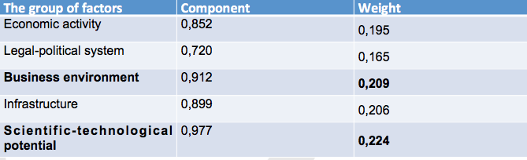
Identification Of The Country’s Attractiveness Factors For Foreign Direct Investments: Ltihuania’s Case

Slide 21
Directions of FDI policy
Liberal (USA-UK School)
Regulatory (German-Scandinavian School). Regulation is difficult to define as it is adopted in different areas

Slide 22
Incentives. Definition
In general, an incentive is understood as any government measure designed to influence an investment decision, or have the effect of increasing the profit, even if these measures do not make direct influence.
FDI incentives - specific measures aimed at either increasing the rate of return of a particular FDI project or reducing its costs or risks.
In literature, investment incentives are defined as “support”, “incentives,” “initiative”, as well as “promotion”.
The disincentive in one region can be regarded as an incentive in a different area of a business or a branch.

Slide 23
Role of Incentives
The primary aim of these incentives is to create a friendly business environment where foreign investors feel comfortable with the legal and financial framework of the country and have the potential to reap profit from economically viable businesses.
Incentives serve to win over foreign investors who are assessing the advantages of various destinations.
Promotion is activity spreading information about an investment-friendly climate or attempting to create a positive image of the country and provide investment services to potential investors, which can be defined as non-financial investment incentives.

Slide 24
Classification of Incentives
Fiscal incentives
Financial incentives
Non-financial incentives
Bilateral, multilateral, and international agreements

Slide 25
Fiscal Incentives
Accelerated depreciation
Tax holidays
Preferential tax rates
Tax exemption
Tax credits, including the measures relating to social security contributions and investment reserves

Slide 26
Fiscal Incentives
Fiscal measures are designed to encourage investment in various business sectors. Fiscal incentives include narrower policy goals:
promotion of regional development,
R&D,
development of Investment Projects
problems of specific business sectors

Slide 27
Financial Incentives
Grants,
Support
Preferential loans
Loan guarantees
Interest rate subsidy
Subsidies for job creation
Subsidies for training

Slide 28
Advantages and Disadvantages of Employing FDI Incentives
Advantages
Disadvantages
Fiscal measures would encourage economic growth.
Grants have the long–term affect on MNCs decisions to make investments
May bring exceptional losses to the state budget.
Rise to costly “bidding wars”.
cause only short–term positive effect in attracting FDI as MNCs tend to “move” their capital and select business–friendly environment

Slide 29
Documents related to the promotion of foreign direct investment in Lithuania

Slide 30
Document | Priority | Measures to attract investment
Investment Law (1999) | Greenfield investments, investment in unfinished buildings; investment in problematic regions; investments in free economic zones, science and technology parks; investment in innovation, investments into centres of knowledge economics – clusters. | Tax incentives; staff retraining costs partially or completely covered; loans to the state (municipal) guarantee; state land leased to the investor at auction.
Free economic zone Act (1995) | In international trade, production and export of financial activities; scientific-technical progress in developing and installing companies and organizations; the creation of new jobs | For rental state land is paid a reduced up to 50per cent land tax; tax holidays; 50per cent reduced income tax rate; dividends are exempt; other tax concessions as regards under the law.
Investment Promotion Programme 2008-2013 | Development of high-tech and medium high-tech sectors, or enhancement of companies generating high value added products; employment issues. | Improving the image of the country; Design and development of investment promotion measures; flexible labour laws; favourable tax environment for businesses; rapid construction permit sand licensing; Provision of EU Structural Funds; PP network expansion
Programme of XV Government | Companies with a global and long-term growth potential; innovative and creating high added value; promoting technical and technological progress. | Not specified
Programme of XVI Government | FDI directed into the industrial sector, their efficiency and development; increasing employment; effective FDI. | Not specified
Investment Pormotion Programme 2014-2020 | High-skilled jobs; high-tech and medium high-tech sectors; services, production and manufacturing companies seeking high-tech and medium-high technology and the use of high value-added product development and their export | Next to financial create tax measures; not into favour of green field investments and its specific areas; removal of bureaucratic and administrative barriers to business; favourable tax environment for business creation; Business Control System’s simplification; liberalization of labour relations; improving the state of infrastructure.

Slide 31
Expert’s Assessment of the Adoption of Foreign Direct investment Incentives
Groups of FDI Incentives | Developing Countries | Developed Countries
Fiscal | 4 | 2
Financial | 1 | 1
Non-financial | 5 | 3
Country’s marketing | 6 | 4
International agreements | 2 | 6
Bilateral agreements | 3 | 5

Slide 32
 | Incentives | Countries
Specific invest-ment incentives | “Start-up” | Australia, India, USA, Canada, China, S. Korea, Mexico, Germany
 | Exemptions | Australia, India, Indonesia, Canada, China
 | Management | Argentina, Brazil, India, Indonesia, China, Mexico, South Africa
 | Specific fiscal measures | Japan, China, Poland
Invest-ment related measures | Legal regulation | Ireland, Canada, China, the Netherlands, Poland, Portugal, Romania, Russia, Saudi Arabia, Hungary, Germany, Turkey
 | Support/ State aid | Argentina, Australia, Austria, Belgium, Brazil, Czech Republic, Denmark, Estonia, Greece, Italy, Japan, United States, United Kingdom, Canada, China, South Korea, Latvia, Luxembourg, Malta, Mexico, Netherlands, Russia, Slovenia, Slovakia Finland, Sweden, Hungary, Germany, the European Union
 | General tax measures | Argentina, Greece, Indonesia, Ireland, Italy, Japan, Canada, China, Russia
 | IIAs (international institution agreements) | Argentina, Australia, Austria, Belgium, Bulgaria, Czech Republic, Denmark, Estonia, Greece, India, Indonesia, Ireland, Italy, Japan, United States, United Kingdom, Canada, China, Cyprus, South Korea, Latvia, Lithuania, Poland , Luxembourg, Malta, the Netherlands, South Africa, France, Portugal, Romania, Russia, Saudi Arabia, Slovenia, Slovakia, Finland, Sweden, Hungary, Germany, Turkey, the European Union

Slide 33
Non-financial incentives
Non-financial incentives include measures, which can at least indirectly determine the future profitability of investments and the potential risks that may affect investors’ plans.
Classification of non-financial incentives
Promotion,
Activities of information providing agencies,
Infrastructure-related assistance,
Preferential government contracts the provision of certain services, and
the establishment of free trade, enterprise and technology zones

Slide 34
Bilateral and Multilateral Agreements

Slide 35
Interconnection Between Inward Foreign Direct Investment And Regulation

Slide 36
Bilateral agreements
BITs are international legal commitments that guarantee the property rights of foreign investors which include expropriation clauses defining what is deemed to be expropriator behaviour and specify compensation and dispute-settlement mechanisms, such as the recourse to international arbitration courts

Slide 37
Advantages and Disadvantages of Employing Bilateral Agreements
Disadvantages
Advantages
the intervention regarding FDI flows reduces the number of investors
host country can benefit from FDI regulation only in a long period of time.
cause bureaucracy and corruption
higher level of regulation attracts more targeted FDI in the host country

Slide 38
ADOPTION OF FISCAL AND FINANCIAL INCENTIVES FOR ATTRACTING FOREIGN DIRECT INVESTMENT

